Slide 1
Requirements Engineering Processes

Slide 2
Objectives
To introduce the notion of processes and process models for requirements engineering
To explain the critical role of people in requirements engineering processes
To explain why process improvements is important and to suggest a process improvement model for requirements engineering

Slide 3
Processes
A process is an organised set of activities which transforms inputs to outputs
Process descriptions encapsulate knowledge and allow it to be reused
Examples of process descriptions
  Instruction manual for a dishwasher
  Cookery book
  Procedures manual for a bank
  Quality manual for software development

Slide 4
Design processes
Processes which involve creativity, interactions between a wide range of different people, engineering judgement and background knowledge and experience
  NHM: Don’t mix this up as (only “software-design”) processes
  NHM: All processes that share the above character are “design” processes
Examples of design processes
  Writing a book
  Organising a conference
  Designing a processor chip
  Requirements engineering

Slide 5
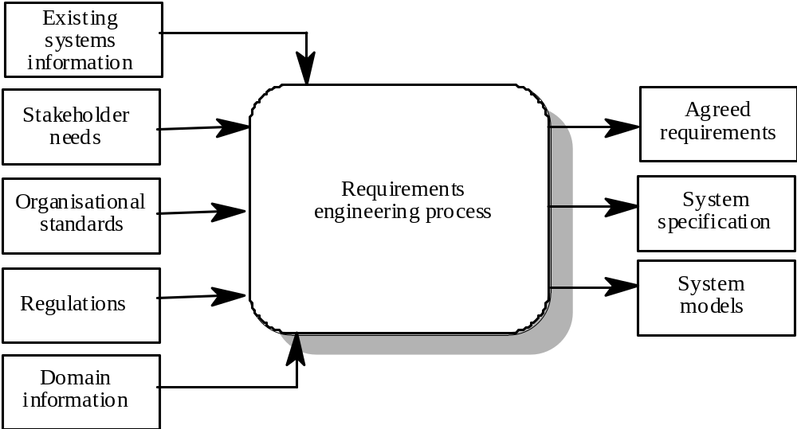
RE process - inputs and outputs

Slide 6
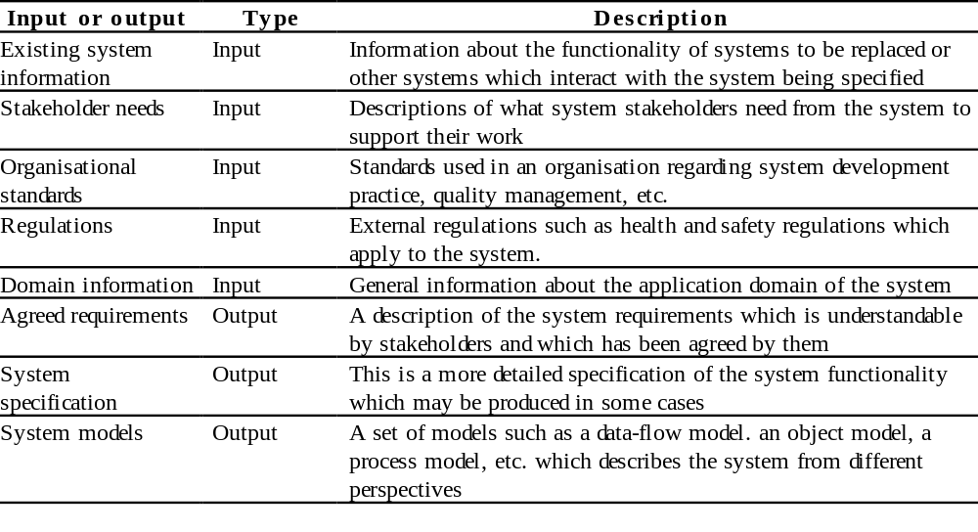
Input/output description

Slide 7
RE process variability
RE processes vary radically from one organisation to another
Factors contributing to this variability include
  Technical maturity
  Disciplinary involvement
  Organisational culture
  Application domain
There is therefore no ‘ideal’ requirements engineering process

Slide 8
RE process variability
Example Sources of variability (NHM):
  Degree of knowledge and experience RE staff have
  Degree of institutionalisation of the overall structures of the RE processes
    Elicitation, analysis, prioritisation, negotiation, validation, etc.
  Use of different techniques and tools in RE
  Management know-how
  Degree of knowledge sharing across the organisation
  How much they are learning from failures (& making improvements)
  Degree of interaction with customers and other key stakeholders
  Open vs. closed shop operation (c.f.: McDonalds vs. a gourmet restaurant)
  Degree of formality
  Types of systems & application domains: IS, systems, real-time, etc.

Slide 9
Process models
A process model is a simplified description of a process presented from a particular perspective
Types of process model include:
  Coarse-grain activity models
  Fine-grain activity models
  Role-action models
  Entity-relation models

Slide 10
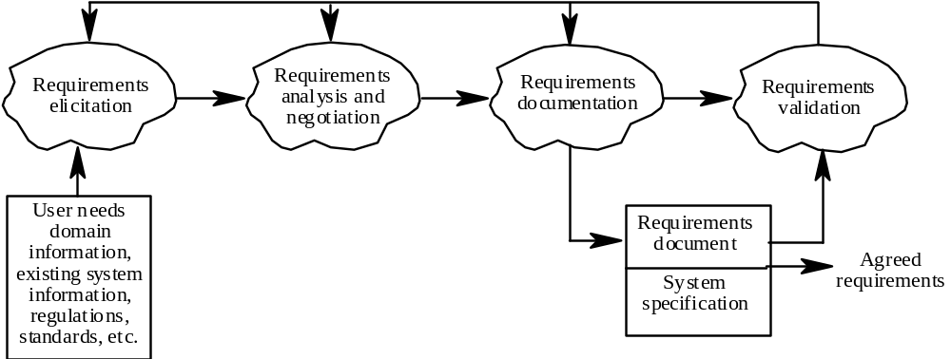
Coarse-grain activity model of RE

Slide 11
RE process activities
Requirements elicitation
  Requirements discovered through consultation with stakeholders
Requirements analysis and negotiation
  Requirements are analysed and conflicts resolved through negotiation
Requirements documentation
  A requirements document is produced
Requirements validation
  The requirements document is checked for consistency and completeness

Slide 12
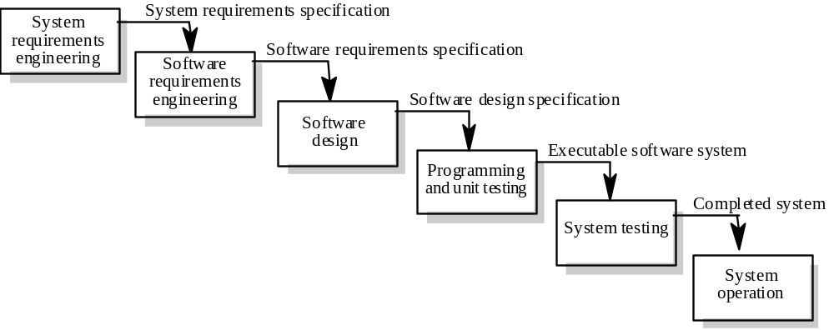
Waterfall model of the software process
Simplified for basic understanding.
Actually:
  iterative (feedback)
  phase boundaries blurred
  prototyping
  inputs/outputs more complex

Slide 13
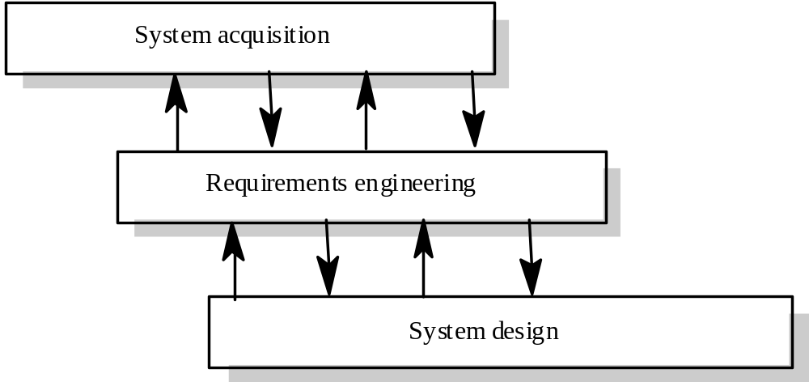
Context of the RE process
Legal, commercial
and contractual issues

Slide 14
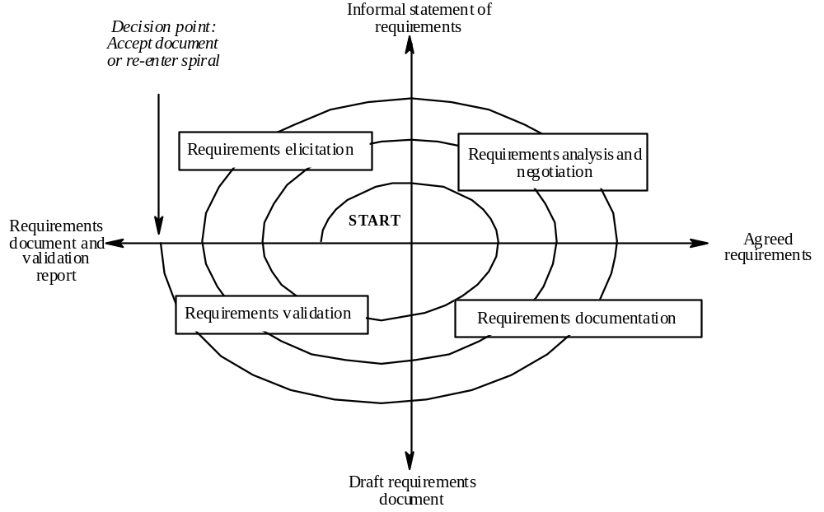
Spiral model of the RE process
RE is an iterative process!

Slide 15
Actors in the RE process
Actors in a process are the people involved in the execution of that process
Actors are normally identified by their roles rather than individually
Requirements engineering involves actors who are primarily interested in the problem to be solved (end-users, etc) as well actors interested in the solution (system designers, etc.)
Role-action diagrams document which actors are involved in different activities

Slide 16
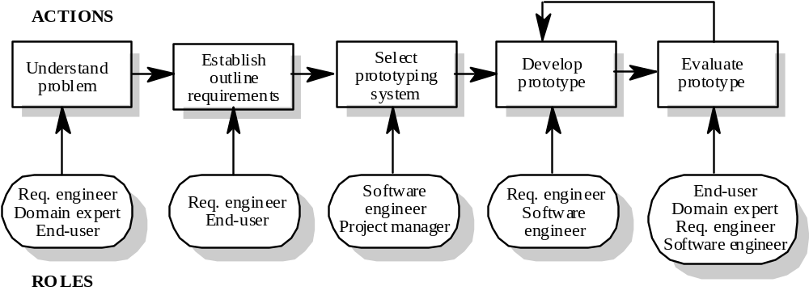
RAD for software prototyping
e.g., Evolutionary v. Throwaway

Slide 17
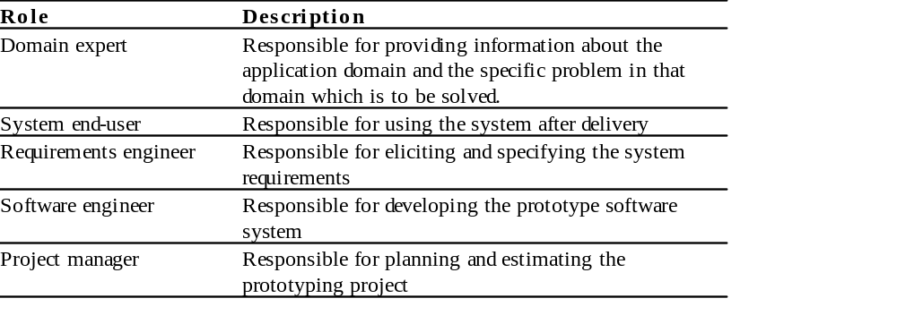
Role descriptions

Slide 18
Human and social factors
Requirements engineering processes are dominated by human, social and organisational factors because they always involve a range of stakeholders from different backgrounds and with different individual and organisational goals.
System stakeholders may come from a range of technical and non-technical background and from different disciplines

Slide 19
Types of stakeholder
Software engineers responsible for system development
System end-users who will use the system after it has been delivered
Managers of system end-users who are responsible for their work
External regulators who check that the system meets its legal requirements
Domain experts who give essential background information about the system application domain

Slide 20
Factors influencing requirements
Personality and status of stakeholders
The personal goals of individuals within an organisation
The degree of political influence of stakeholders within an organisation
NHM:
Domain & RE expertise.
Technological support for RE processes.
Reqts. implemented in the base system.
Reqts. volatility.
Implementation cost, time, feasibility, etc.
Other.

Slide 21
Process support
CASE tools provide automated support for software engineering processes
The most mature CASE tools support well-understood activities such as programming and testing and the use of structured methods
Support for requirements engineering is still limited because of the informality and the variability of the process

Slide 22
CASE tools for RE
Modelling and validation tools support the development of system models which can be used to specify the system and the checking of these models for completeness and consistency. The tool package which supports this book includes this type of tool.
  VORD.
  Other: Rationale Rose for developing UML models.
Management tools help manage a database of requirements and support the management of changes to these requirements.
NHM: Other tools for RE:
DOORS
Requisite Pro
traceability tools

Slide 23
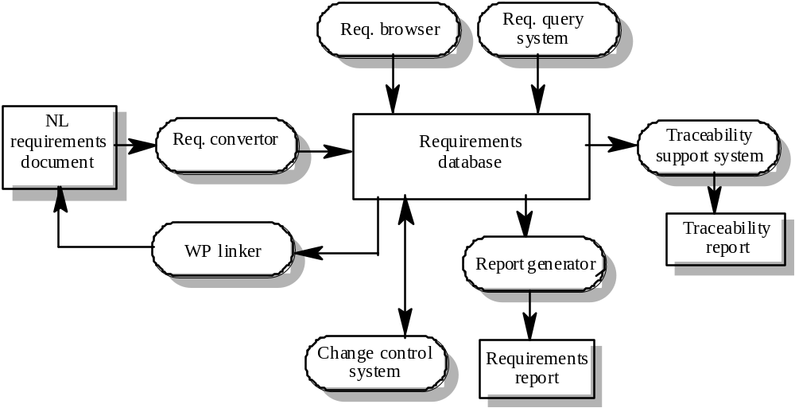
A requirements management system
There can be advanced tools such as:
Requirements Escalation Management
Requirements Degeradation Management
Such tools are at the research stage currently.
NL: natural language
WP: word processor

Slide 24
Requirements management tools
Requirements browser
Requirements query system
Traceability support system
Report generator
Requirements converter and word processor linker
Change control system

Slide 25
Process improvement
Process improvement is concerned with modifying processes in order to meet some improvement objectives
Improvement objectives
  Quality improvement
  Schedule reduction
  Resource reduction

Slide 26
Planning process improvement
What are the problems with current processes?
What are the improvement goals?
How can process improvement be introduced to achieve these goals?
How should process improvements be controlled and managed?

Slide 27
RE process problems
Some more example problems:
Too many field defects related to requirements
Too much backtracking during/from architecting
Requirements testability failure-rate seems high
Requirements traceability down the process difficult
Requirements are difficult to measure
We just meet, not exceed, our clients’ “expectations”
We have no idea how “fit” the solution is at the end of the requirements process and before moving into design
etc.
Lack of stakeholder involvement
Business needs not considered
Lack of requirements management
Lack of defined responsibilities
Stakeholder communication problems
Over-long schedules and poor quality requirements documents
Go, check out Bugzilla.
It should have requirements and related
Defects in the database for systems such as
Apache, Mozilla, Eclipse, etc.

Slide 28
Process maturity
Process maturity can be thought of as the extent that an organisation has defined its processes, actively controls these processes and provides systematic human and computer-based support for them.
The SEI’s Capability Maturity Model is a framework for assessing software process maturity in development organisations

Slide 29
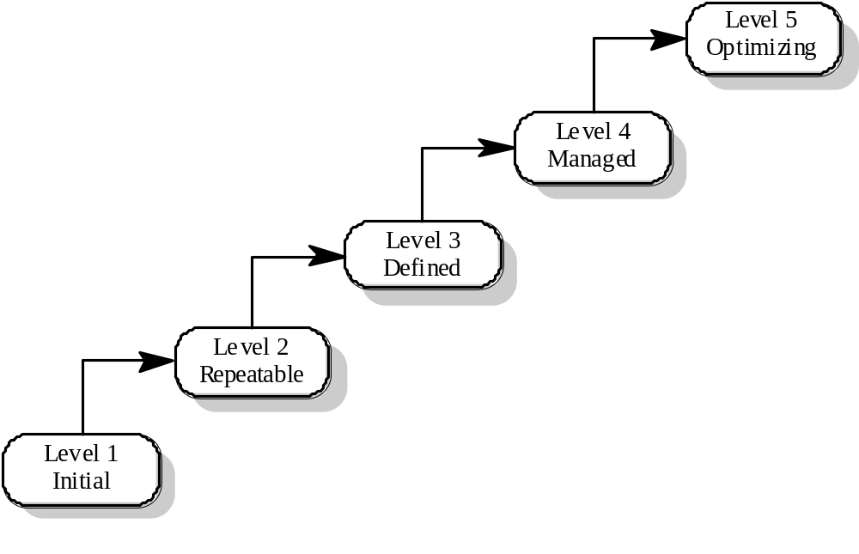
Capability maturity model

Slide 30
Maturity levels
Initial level
  Organisations have an undisciplined process and it is left to individuals how to manage the process and which development techniques to use.
Repeatable level
  Organisations have basic cost and schedule management procedures in place. They are likely to be able to make consistent budget and schedule predictions for projects in the same application area.
Defined level
  The software process for both management and engineering activities is documented, standardized and integrated into a standard software process for the organisation.

Slide 31
Maturity levels
Managed level
  Detailed measurements of both process and product quality are collected and used to control the process.
Optimizing level
  The organisation has a continuous process improvement strategy, based on objective measurements, in place.
CMM does not specifically refer to RE process maturity.

Slide 32
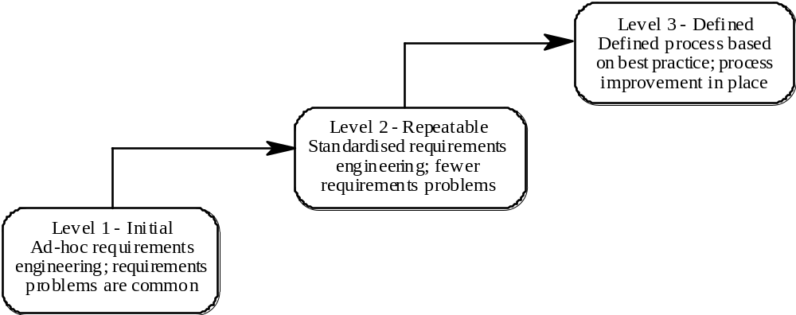
RE process maturity model
Roughly_corresponds_to
Roughly_corresponds_to
CMM levels 3,4 &5
CMM levels 1 & 2

Slide 33
RE process maturity levels
Initial level
  No defined RE process. Suffer from requirements problems such as requirements volatility, unsatisfied stakeholders and high rework costs. Dependent on individual skills and experience.
Repeatable level
  Defined standards for requirements documents and policies and procedures for requirements management.
Defined level
  Defined RE process based on good practices and techniques. Active process improvement process in place.

Slide 34
Good practice for RE process improvement
RE processes can be improved by the systematic introduction of good requirements engineering practice
Each improvement cycle identifies good practice guidelines and works to introduce them in an organisation

Slide 35
Examples of good practice guidelines
Define a standard document structure
Uniquely identify each requirement
Define policies for requirements management
Use checklists for requirements analysis
Use scenarios to elicit requirements
Specify requirements quantitatively
Use prototyping to animate requirements
Reuse requirements

Slide 36
Key points
The requirements engineering process is a structured set of activities which lead to the production of a requirements document.
Inputs to the requirements engineering process are information about existing systems, stakeholder needs, organisational standards, regulations and domain information.
Requirements engineering processes vary radically from one organisation to another. Most processes include requirements elicitation, requirements analysis and negotiation and requirements validation.

Slide 37
Key points
Requirements engineering process models are simplified process description which are presented from a particular perspective.
Human, social and organisational factors are important influences on requirements engineering processes.
Requirements engineering process improvement is difficult and is best tackled in an incremental way.
Requirements engineering processes can be classified according to their degree of maturity.

